Slide 1
HOTEL NETWORKING MANAGEMENT SYSTEM USING CISCO PACKET TRACER
MEMBERS:
AYAN
SHEHARYAR
AAKIFAH
EHTISHAM
JAWWAD

Slide 2
INTRODUCTION:
COMPONENT USED:
PCS
SWITCH
ROUTER
IP
PRINTER
PHONES
Today, networks may be built by connecting various devices such as computers, phones, printers, mobile devices, and so on, either wired or wirelessly. Computers or computers that we use at home can be considered part of a network. Because the internet is a network, there are only speed and quota restrictions. Various networks can share resources or information via the internet, and the interconnectedness of these networks can be graphically represented by many software.

Slide 3
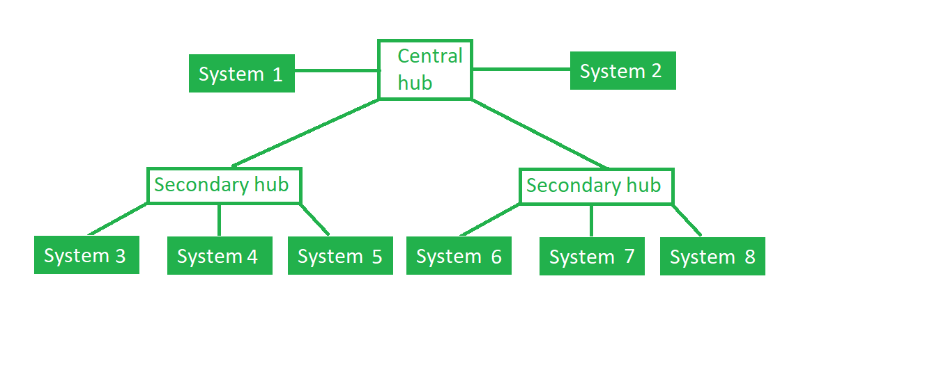
DESCRIPTION:
THIS PROJECT CONSIST TOTAL Five ROOM
Office 1 area, Office 2 area, Office 3 area, Office 4 area, and reception area. Three routers are positioned between the rooms to offer the ultimate connectivity to all of the rooms as needed.
TOPOLOGY USED:
TREE TOPOLOGY:
This topology is the variation of the Star topology. This topology has a hierarchical flow of data. In Tree Topology, protocols like DHCP and SAC (Standard Automatic Configuration ) are used. In a tree topology, there can be only one connection between any two connected nodes. Because any two nodes can have only one mutual connection, tree topologies create a natural parent and child hierarchy.

Slide 4
ADVANTAGES AND DISADVANTAGES OF TREE TOPOLOGY:
Advantages of Tree Topology :
This topology is a combination of bus and star topology.
This topology provides a hierarchical as well as central data arrangement of the nodes.
As the leaf nodes can add one or more nodes in the hierarchical chain, this topology provides high scalability.
The other nodes in a network are not affected if one of their nodes gets damaged or does not work.
Tree topology provides easy maintenance and easy fault identification can be done.
A callable topology. Leaf nodes can hold more nodes.
Supported by several hardware and software vendors.
Point-to-point wiring for individual segments.
Tree Topology is highly secure.
It is used in WAN.
Tree Topology is reliable.

Slide 5
Disadvantages of Tree Topology :
This network is very difficult to configure as compared to the other network topologies.
The length of a segment is limited & the limit of the segment depends on the type of cabling used.
Due to the presence of a large number of nodes, the network performance of tree topology becomes a bit slow.
If the computer on the first level is erroneous, the next-level computer will also go under problems.
Requires a large number of cables compared to star and ring topology.
As the data needs to travel from the central cable this creates dense network traffic.
The Backbone appears as the failure point of the entire segment of the network.
Treatment of the topology is pretty complex.
The establishment cost increases as well.
If the bulk of nodes is added to this network, then the maintenance will become complicated.

Slide 6
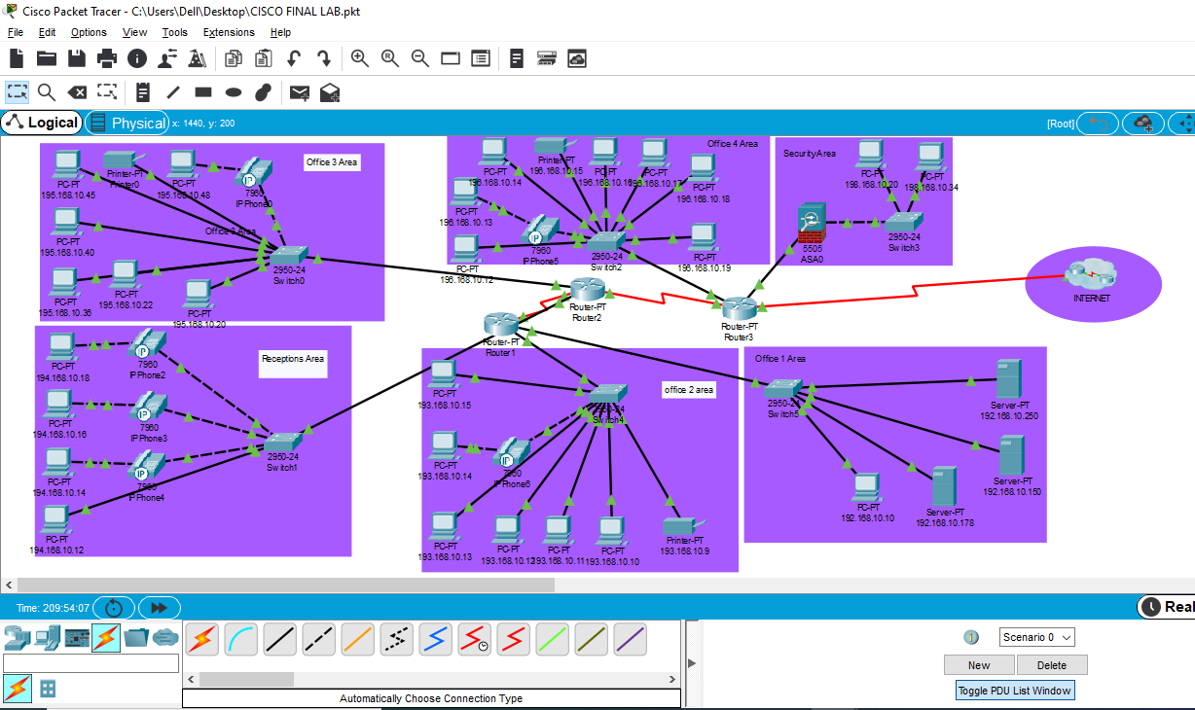

Slide 7
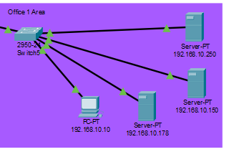
In office area 1 we have three CPUs and a PC connected to a switch and the switch is connected to router 1.

Slide 8
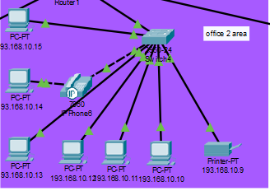
Office area 2 has six PCs, one IP phone, and a printer connected to a switch and the switch is connected to router 1 as well.

Slide 9
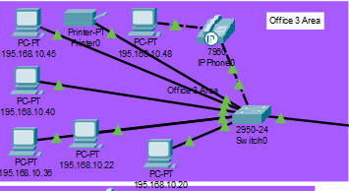
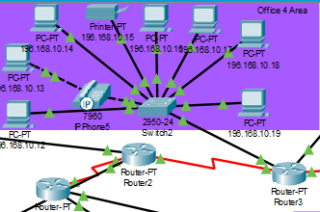
Office 3 has 6 PCs, an IP phone, and a printer like office 2 connected to a switch and a switch connected to router 2.
Office area 4 has 7 PCs, an IP phone, and a printer, all of these are connected to a switch and the switch is connected to router 3.

Slide 10
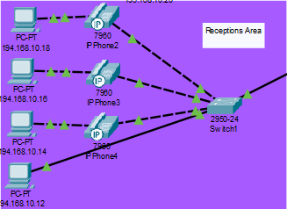
And last but not least we have a reception area which consists of 4 PCs, 3 telephones and a switch connected to router 2.

Slide 11
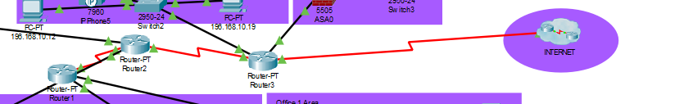
All of these routers are also connected to each other in a way that router 2 is connected to router 1 and router 3, and router 3 is connected to an internet source.

Slide 12
PODUCT FEATURES:
This network is based on client-server architecture.
Tree topology is used here
3 client routers are present for the four levels of the Hotel and they are associated with a server
All the departments are categorized into various LANs, which are connected to the 3 routers based on the sequence in which they are accommodated in the story
Likewise, various departments are limited to LANs and share router corresponding to their levels.
A request is made by any system of any department and it is forwarded to the client switch, which furthermore transmits it to the router and then to the server.
Port-securities are there that are executed on various switches ports and give reliability.
The data is then transferred to its connected router. The router serves as a DHCP server for assigning IPs to the host computers and also generally routes the data to the desired destination

Slide 13
CONCLUSION:
Design the network outlook for the community Hotel network scenario produces the substructure for all other exposure in the service framework such as wireless area network, mobility, and the justification to provide safety and security, operational efficiencies, virtual environments, and secure rooms. This paper describes the network design scenario on the Cisco Packet Tracer and where we can apply these scenarios within the various locations of a community Hotel network. Finally, key network foundation services such as switching, routing, multicast, and high availability are given for the full Hotel network scenario.

